Slide 1
Math Basics
Session 2: (Linear Algebra Fundamentals)

Slide 2
Agenda:
1 | Vectors and Matrices
2 | Matrix Operations
3 | Linear Transformations and Eigenvalues

Slide 3
Vectors and Matrices

Slide 4
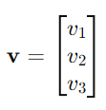
Vector
A vector is an ordered list of numbers (scalars) that can represent a point in space. Vectors have both magnitude (length) and direction. In the context of AI, vectors are used to represent data points, features, or weights.
Vectors are typically represented as columns (column vectors) or rows (row vectors). For example, a 3-dimensional vector can be written as:

Slide 5

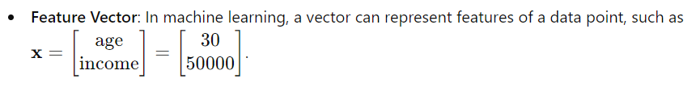
Vectors
Examples

Slide 6

Operations on Vectors
Addition
Vectors of the same dimension can be added by adding corresponding elements:

Slide 7

Operations on Vectors
Subtraction
Similar to addition, but subtracting corresponding elements.
Scalar Multiplication
Multiplying a vector by a scalar (number) scales each element of the vector:

Slide 8


Matrices
A matrix is a rectangular array of numbers arranged in rows and columns. Matrices can represent multiple vectors, data tables, or linear transformations.
A matrix 𝐴 with 𝑚 rows and 𝑛 columns is denoted as For example, a 2x3 matrix looks like this:

Slide 9
Matrices
Examples
Data Matrix: In a dataset, each row could represent a different data point (case), and each column could represent a different feature (variable).
Transformation Matrix: Matrices can be used to perform transformations like rotations, scaling, or translations in space

Slide 10
Why Vectors and Matrices are Important in AI and Machine Learning ?
Data Representation: Vectors and matrices are used to represent datasets, where each row is a data point and each column is a feature.
Linear Transformations: Matrices can represent transformations applied to data, such as scaling, rotating, and translating data points in space.
Matrix Operations: Essential for performing calculations in machine learning algorithms, such as linear regression, neural networks, and principal component analysis (PCA).

Slide 11
Summary
Vectors represent points or directions in space and can be used to model features of data points.
Matrices represent more complex data structures and transformations and are fundamental tools for organizing and manipulating data in AI.
Understanding vector and matrix operations is crucial for implementing and optimizing machine learning algorithms.

Slide 12
Matrix Operations

Slide 13
Matrix Operations
This segment covers essential matrix operations that are fundamental for understanding how data is manipulated and transformed in AI and machine learning. Matrix operations enable the efficient computation of complex transformations, solving systems of linear equations, and performing various data manipulations.

Slide 14
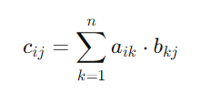
Matrix Multiplication
Matrix multiplication is a way of combining two matrices to produce a new matrix. The number of columns in the first matrix must match the number of rows in the second matrix for multiplication to be possible.
Notation:
If A is an m×n matrix and 𝐵 is an n×p matrix, the product AB is an m×p matrix.
Formula:
Each element of the resulting matrix C=AB is calculated as the dot product of a row in 𝐴 and a column in 𝐵:

Slide 15
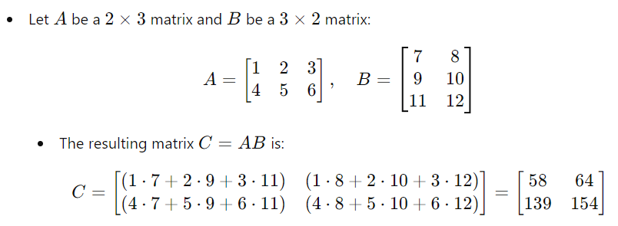
Matrix Multiplication
Example

Slide 16

Determinant of a Matrix
The determinant is a scalar value that can be computed from the elements of a square matrix. It provides important properties of the matrix, such as whether it is invertible (non-singular).
Notation:
For a square matrix A, the determinant is denoted as det(A) or ∣A∣.
Formula for a 2x2 Matrix

Slide 17
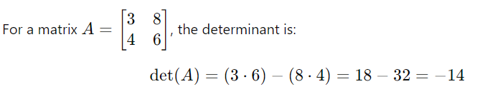
Determinant of a Matrix
Example

Slide 18


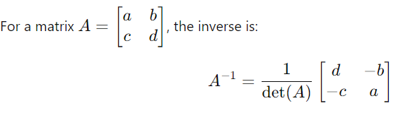
Inverse of a Matrix
The inverse of a matrix A is a matrix such that when it is multiplied by A, it results in the identity matrix
Conditions:
A matrix must be square (same number of rows and columns) and have a non-zero determinant to have an inverse.
Formula for a 2x2 Matrix

Slide 19
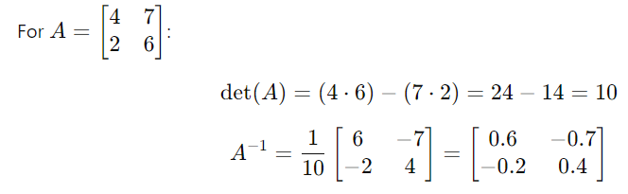
Inverse of a Matrix
Example

Slide 20
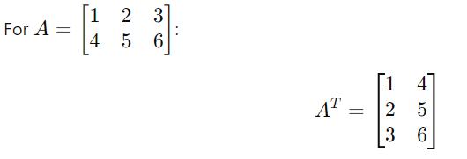
Transpose of a Matrix
The transpose of a matrix is obtained by flipping the matrix over its diagonal, converting rows into columns.
Notation:
If A is a matrix, the transpose is denoted by
Example

Slide 21
Summary
Matrix multiplication is crucial for data transformations and neural network operations.
Determinants help determine the properties of matrices, such as invertibility.
Matrix inverses are used to solve linear equations and optimize models.
Matrix transposition is essential for aligning data dimensions and preparing matrices for multiplication.

Slide 22

Types of Matrices
Square Matrix
A matrix with the same number of rows and columns (e.g., n×n). It’s used often in linear transformations and finding determinants.
Example:

Slide 23

Types of Matrices
Diagonal Matrix
A square matrix where all non-diagonal elements are zero. Only the diagonal elements may be non-zero.
Example:

Slide 24

Types of Matrices
Identity Matrix
A special type of diagonal matrix where all the diagonal elements are 1. It acts as the multiplicative identity in matrix operations.
Example:

Slide 25

Types of Matrices
Zero Matrix
A matrix where all elements are zero. It's the additive identity in matrix operations.
Example:

Slide 26

Types of Matrices
Row Matrix
A matrix with only one row.
Example:

Slide 27


Types of Matrices
Symmetric Matrix
A matrix with only one row.
A square matrix that is equal to its transpose
Example:

Slide 28
Linear Transformations and Eigenvalues

Slide 29
Linear Transformations and Eigenvalues
This segment covers the concepts of linear transformations and eigenvalues, which are fundamental in understanding how data can be manipulated and analyzed in various dimensions. These concepts play a crucial role in areas such as dimensionality reduction, stability analysis, and optimization in AI and machine learning.

Slide 30
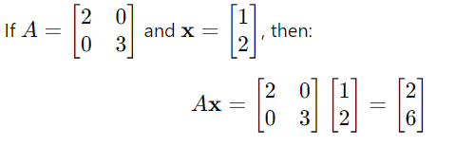
Linear Transformations
A linear transformation is a function that maps vectors from one space to another, preserving vector addition and scalar multiplication. Essentially, it transforms vectors while maintaining the structure of the space.
Matrix Representation
Matrix Representation Linear transformations can be represented by matrices. If 𝑥 is a vector and A is a matrix, then Ax is a linear transformation of 𝑥.
Example:

Slide 31

Common Types of Linear Transformations
Scaling
Changes the size of vectors. Represented by a diagonal matrix where each diagonal element scales the corresponding dimension.
Example:

Slide 32

Common Types of Linear Transformations
Rotation
Rotates vectors around the origin. Represented by a rotation matrix.
Example in 2D:

Slide 33

Common Types of Linear Transformations
Reflection
Flips vectors over a specified line (in 2D) or plane (in 3D).
Example in 2D:

Slide 34

Common Types of Linear Transformations
Shearing
Distorts the shape of vectors in one direction while keeping the other direction unchanged.
Example in 2D:

Slide 35
Eigenvalues and Eigenvectors
In the context of a linear transformation, an eigenvector of a matrix 𝐴 is a non-zero vector that only changes by a scalar factor when 𝐴 is applied to it. The scalar is known as the eigenvalue.
Eigenvalue (𝜆): A scalar indicating how much the eigenvector is stretched or compressed.
Eigenvector (𝑣): A vector that does not change its direction during the transformation.

Slide 36

Eigenvalues and Eigenvectors
Mathematical Formulation
Where:
A is the transformation matrix.
v is the eigenvector.
λ is the eigenvalue.

Slide 37

Eigenvalues and Eigenvectors
Finding Eigenvalues and Eigenvectors
To find eigenvalues, solve the characteristic equation:
Once eigenvalues (𝜆) are known, solve (A−λI)v=0 to find the corresponding eigenvectors.

Slide 38



Eigenvalues and Eigenvectors
Example:
1. Calculate the characteristic equation:
2. Solve for λ\lambdaλ:
So, the eigenvalues are λ=5 and λ=2.
3. Substitute each λ back into (A−λI)v=0 to find the eigenvectors.

